Slide 1
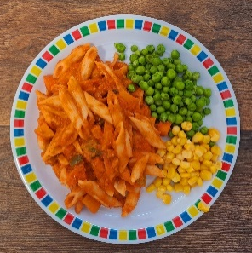
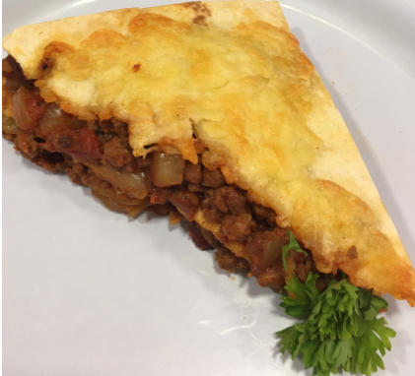
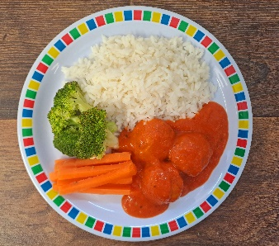
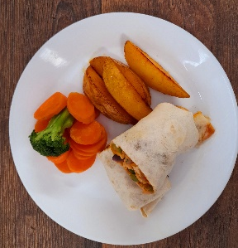
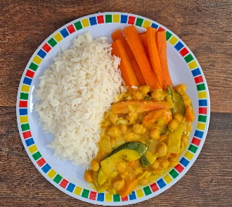
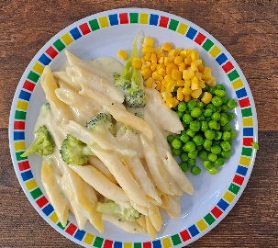
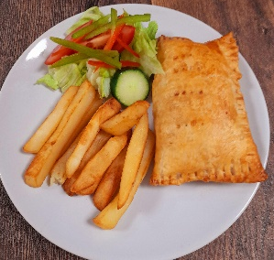
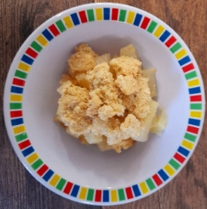
Autumn Winter 2024/2025
Tomato and Vegetable Pasta
Beef Tortilla Stack
Roast Turkey with Roast Potatoes
NEW Chicken Meatballs in Tomato Sauce with Rice
Salmon or Pollock Fish Fingers with Chips & Tomato Sauce
Mexican Fajitas with Rice
Sweet Potato & Lentil Curry
Quorn Fillet with Roast Potatoes
NEW Cheese and Broccoli Pasta with Garlic Bread
Cheese & Bean Puffl with Chips and Tomato Sauce
Apple and Blackberry Crumble with Custard
Melting Moment Biscuit
Berry Mousse
Chocolate Drizzle Cake with Chocolate Sauce
Oaty Cookie

Slide 2
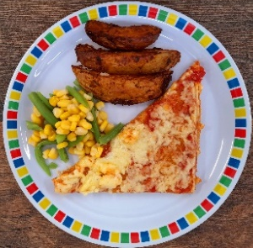
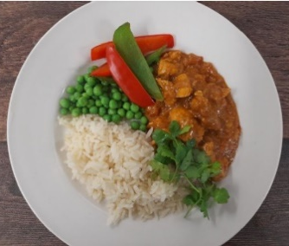
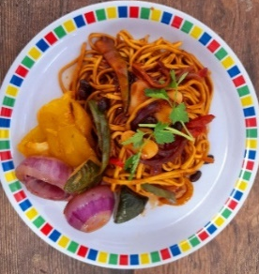
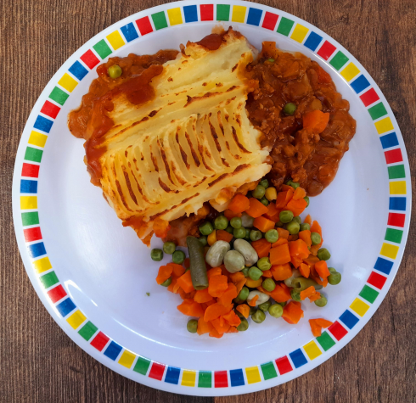
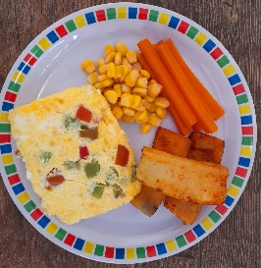
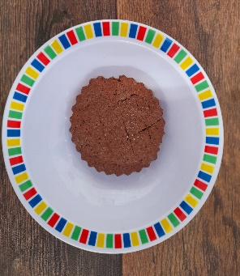
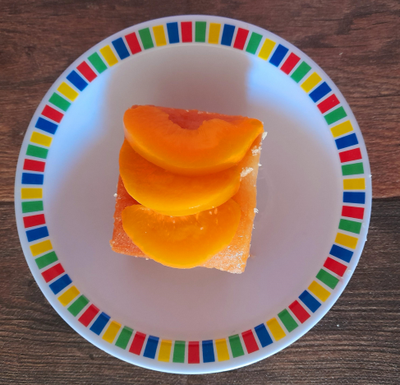
Autumn Winter 2024/2025
Classic Cheese and Tomato Pizza with Wedges
NEW Chicken Pasta Bake with Garlic Bread
Sausage with Roast Potatos and Gravy
Chicken Tikka Masala with Rice
Fish Fingers with Chips & Tomato Sauce
Chinese Vegetable Noodles
Veggie Cottage Pie
Vegan Sausage with Roast Potatoes and Gravy
Homity Pie with new Potatoes
Cheese and Pepper Omelette with Chips and Tomato Sauce
Chocolate Orange Cookie
Marble Sponge with Custard
Jelly with Mandarins
Peach Cake
Vanilla Shortbread

Slide 3
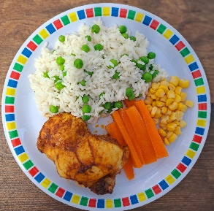
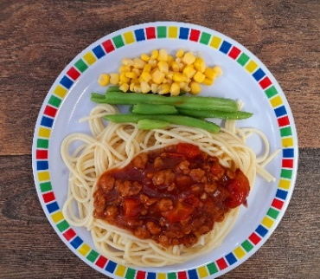
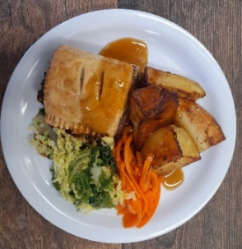
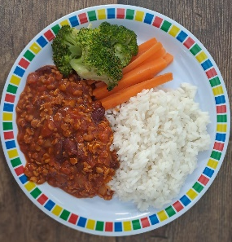
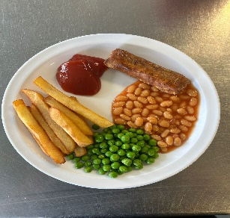
Autumn Winter 2024/2025
Macaroni Cheese
NEW Mild Caribbean Chicken with Rice and Peas
Roast Chicken with Stuffing, Roast Potatoes and Gravy
Spaghetti Bolognaise
Breaded Fish with Chips & Tomato Sauce
NEW veggie Baked Bean Hotpot
Pepper & Cheese Whirl with New Potatoes
Vegetable Wellington with Roast Potatoes with Gravy
NEW Mild Mexican Veggie Chilli with Rice
Veggie Sausage with Chips & Tomato Sauce
Chocolate and Beetroot Brownie
Sticky Toffee Apple Crumble with Custard
Rice Pudding with Berries
Vanilla Shortbread
Chocolate Cookie

